Slide 1




DCF Valuation: A Step-by-Step Guide
DCF valuation is a method used to determine the intrinsic value of a business by discounting its future cash flows to their present value.
AM
by Anoop Mohanty

Slide 2
Understanding the Discounted Cash Flow (DCF) Model
Forecasting
Discounting
Terminal Value
Projecting the company's future cash flows for a period of time. This involves analyzing historical data and making assumptions about future growth.
Discounting those future cash flows back to the present using a discount rate that reflects the risk of the company.
Estimating the value of the company's cash flows beyond the forecast period. This is usually calculated using a perpetuity growth model.

Slide 3
Projecting Future Cash Flows
1
Sales Growth
Projecting future sales based on industry trends, market share, and company-specific factors.
2
Cost of Goods Sold
Estimating future costs based on historical data and assumptions about pricing and efficiency.
3
Operating Expenses
Projecting administrative, marketing, and other operating expenses based on historical trends and future plans.
4
Capital Expenditures
Forecasting future investments in property, plant, and equipment.
5
Working Capital
Projecting changes in working capital, including accounts receivable, inventory, and accounts payable.

Slide 4


Estimating the Weighted Average Cost of Capital (WACC)
1
Cost of Equity
2
Cost of Debt
The return required by investors for holding the company's stock.
The interest rate the company pays on its debt.
3
Capital Structure
4
Tax Rate
The proportion of debt and equity in the company's financing.
The company's effective tax rate.

Slide 5

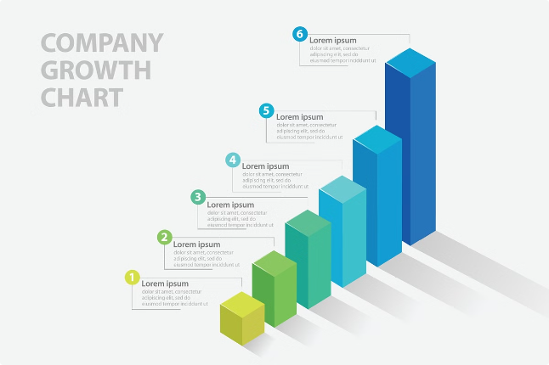
Calculating the Terminal Value
Perpetuity Growth Model
Exit Multiple Method
This method uses industry multiples to estimate the terminal value based on the company's expected future earnings or cash flows.
This model assumes that the company's cash flows will grow at a constant rate forever after the forecast period.

Slide 6

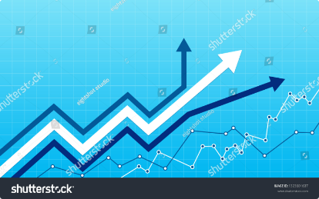


Discounting Future Cash Flows to Present Value
Discount Rate
The discount rate is used to reflect the time value of money and the risk associated with the company.
Present Value
The present value of each future cash flow is calculated by discounting it back to the present using the discount rate.

Slide 7

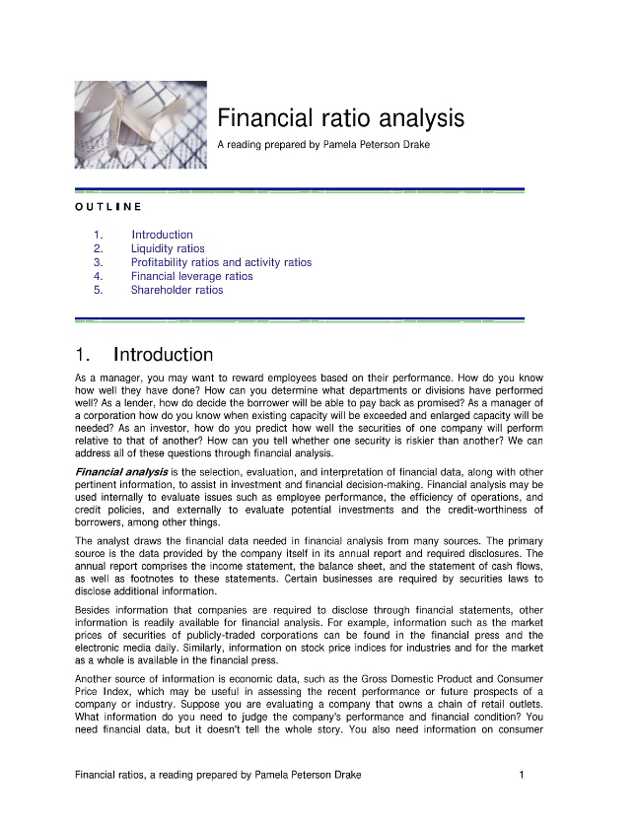
Adjusting for Non-Operating Assets and Liabilities
Cash and Marketable Securities
These are added back to the enterprise value.
Debt
This is subtracted from the enterprise value.
Non-Operating Assets
These are added back to the enterprise value.
Non-Operating Liabilities
These are subtracted from the enterprise value.

Slide 8




Determining the Enterprise Value
Free Cash Flow
Non-Operating Adjustments
The sum of all the discounted future cash flows, including the terminal value.
The enterprise value is adjusted to reflect non-operating assets and liabilities.

Slide 9


Calculating the Equity Value
1
Enterprise Value
2
Net Debt
The total value of the company, including debt and equity.
The total debt minus cash and marketable securities.
3
Equity Value
The value of the company's equity, which represents the value of the company that belongs to the shareholders.

Slide 10

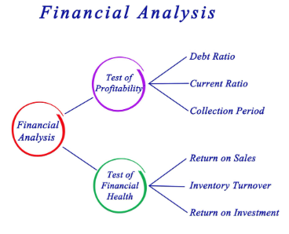
Conclusion and Limitations of DCF Valuation
DCF valuation is a powerful tool for determining the intrinsic value of a business. However, it has limitations, including the difficulty in forecasting future cash flows and estimating the discount rate.

